Slide 1
Lightning Talk 4 – Project Planning
sdmay25-16

Slide 2
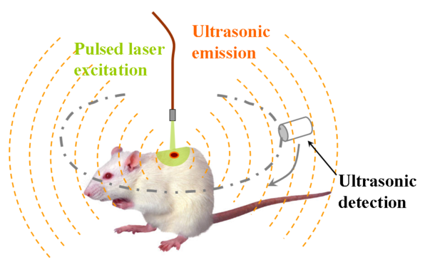
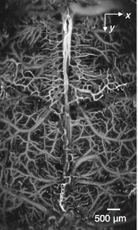
Project Overview
Problem Statement: Design and build an 8/16 channel amplifier with low noise to boost ultrasound signals received for a photoacoustic imaging system.
PC
(imaging software)
Amplifier

Slide 3
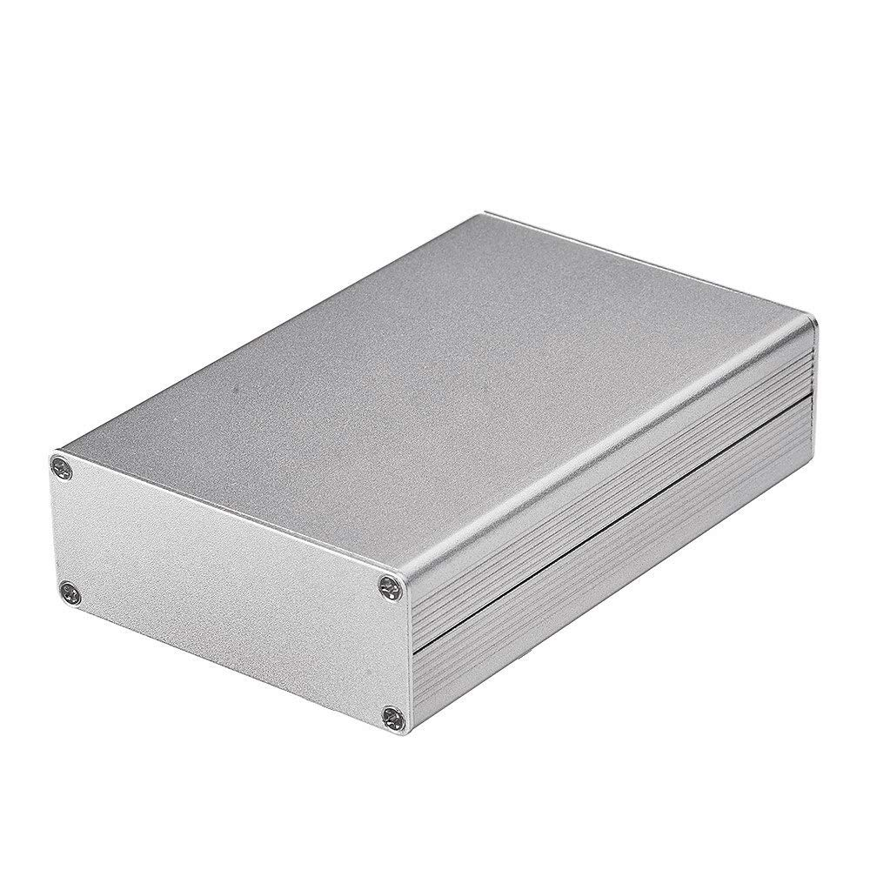
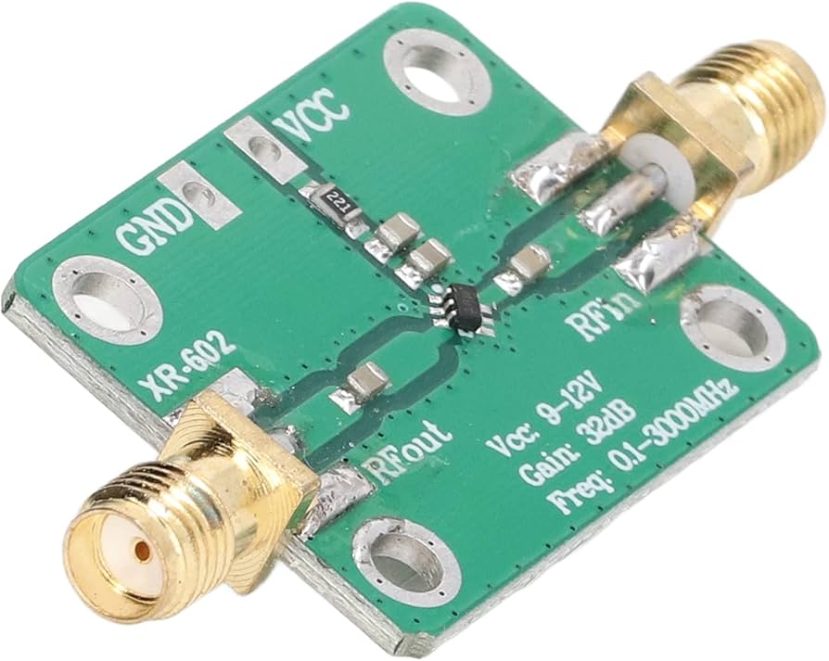
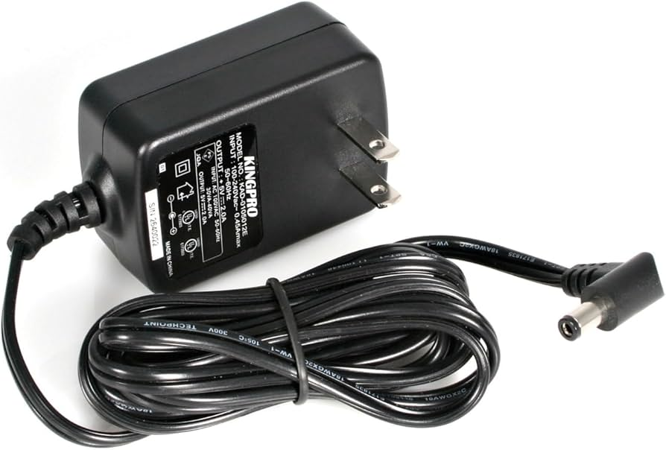
Project Overview
Enclosure
Amplifier Circuit (x16)
Design Specifications:
Low noise
Low input impedance
Bandpass filtering: 10kHz-10MHz
Small size (< 5x5 cm each)
ESD protection
Easily mountable
Power Supply

Slide 4

Project Management Style
Hybrid between Waterfall and Agile
Waterfall:
Working on tasks in order
Most tasks rely on previous tasks to be completed
Long term schedule of ordered tasks
Agile:
Working simultaneously on simulations and lab testing the prototype
Applying learnings from simulation to lab tests and using lab tests to improve simulations
Weekly meetings with and feedback from project owner/client
Adaptive Timeline

Slide 5
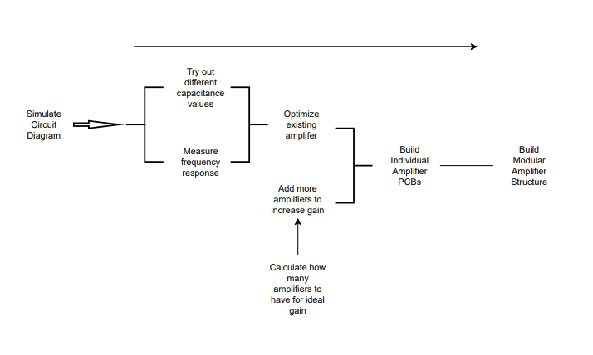
Task Decomposition

Slide 6

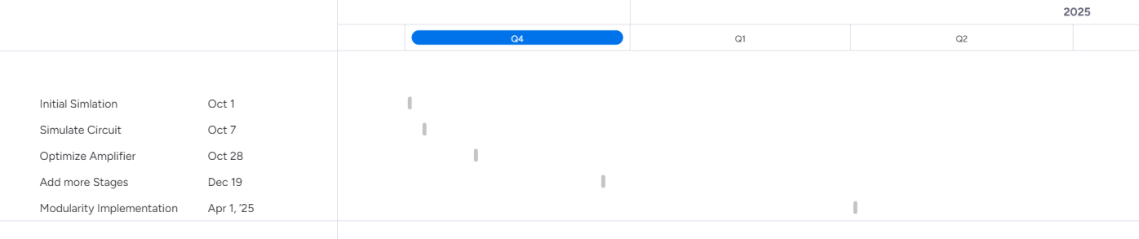
Milestones
Simulation
Optimization
Increase Amplifier gain (by adding more stages)
Implement modularity into design

Slide 7

Risks and Risk Mitigation
Risks:
Not possible to run a completely accurate simulation
Part procurement and assembly
Probability of Failure:
Medium
Low
Consequences:
Differences between simulation and board testing
Delay in work
Risk Mitigation:
Testing existing board to verify and refine simulation
Schedule time to account for part delays

Slide 8
Conclusions
Thinking about the application and what needs to be done differently for it to work for the photoacoustic sensor
Because of the nature of the project a hybridization of agile and waterfall management styles seems the best.
We have fluid milestones due to a mostly linear set of steps
Most of our risks are fairly minor and will only cause a small delay, which is accounted for with the fluidity of the milestones

